Slide 1
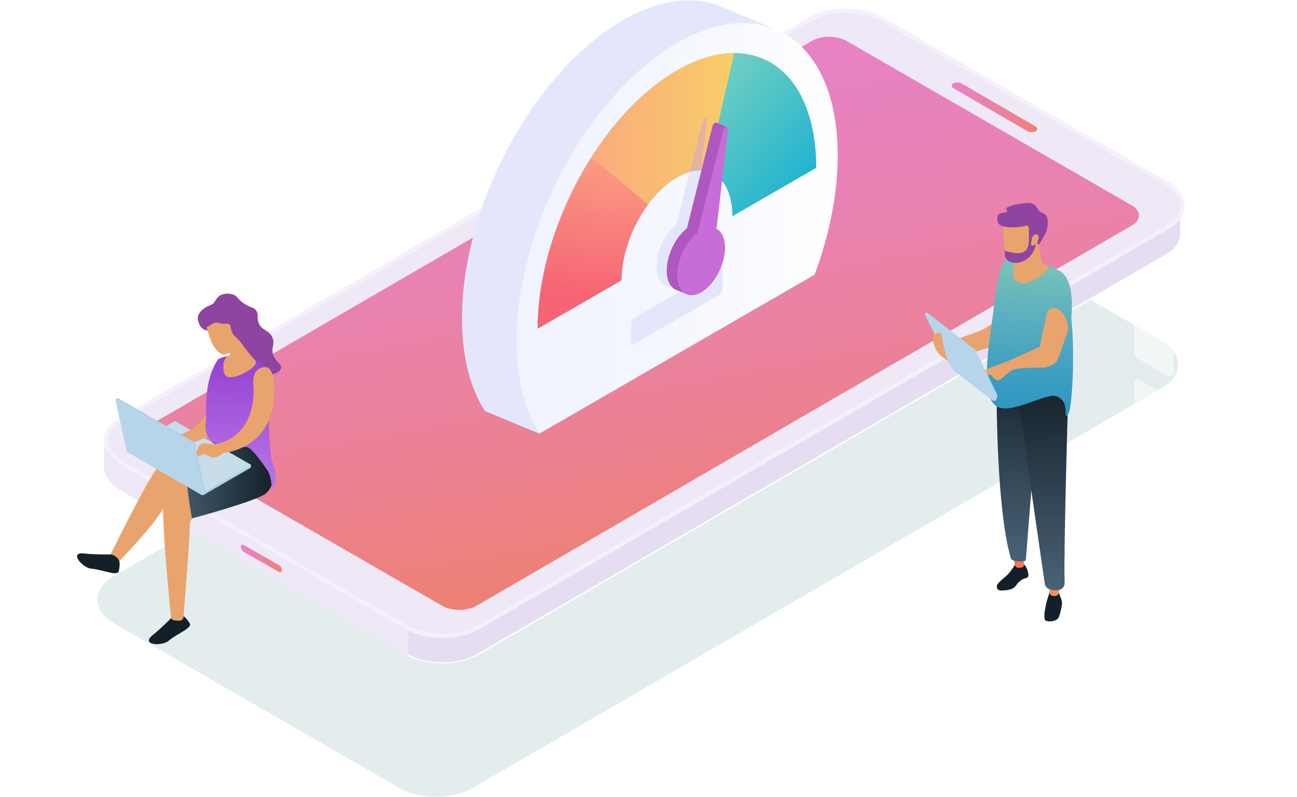
Your Logo Here
Fast Websites Matter:
Google Core Web Vitals & Site Speed
Youragency.com | 1-415-555-1212 | contact@youragency.com

Slide 2
What’s in this Presentation?
Why fast websites matter to business
Google Core Web Vitals
What is a good website performance score?
How you can make your site fast
How we can help
Your Logo Here

Slide 3

Why Fast Websites Matter to Business
Your Logo Here

Slide 4
Fast Websites Convert Better
Conversions drop by 2% to 4% for every second it takes a website to load
The first five seconds of page load time have the highest impact on website conversion rates
Your Logo Here
Notes:
0-4 second load time is best for conversion rates
The first 5 seconds of page load time have the highest impact on conversion rates
Website conversion rates drop by an average of 4.42% with each additional second of load time (between seconds 0-5)
Website conversion rates drop by an average of 2.11% with each additional second of load time (between seconds 0-9)
Source: https://www.portent.com/blog/analytics/research-site-speed-hurting-everyones-revenue.htm#:~:text=The%20first%205%20seconds%20of,(between%20seconds%200%2D5)

Slide 5

Fast Websites Provide a Better Experience for Users
Users won't wait for a slow web page to load, since there are many other options available that are just a click away
Web pages that don’t provide a good experience will turn off site visitors
Visitors abandon sites at 10x rate when a web page goes from 2sec to 10sec load time
Your Logo Here
Notes:
Source: https://www.pingdom.com/blog/page-load-time-really-affect-bounce-rate/#:~:text=What%20we%20found%20was%20that,time%20it%20hits%205%20seconds!

Slide 6
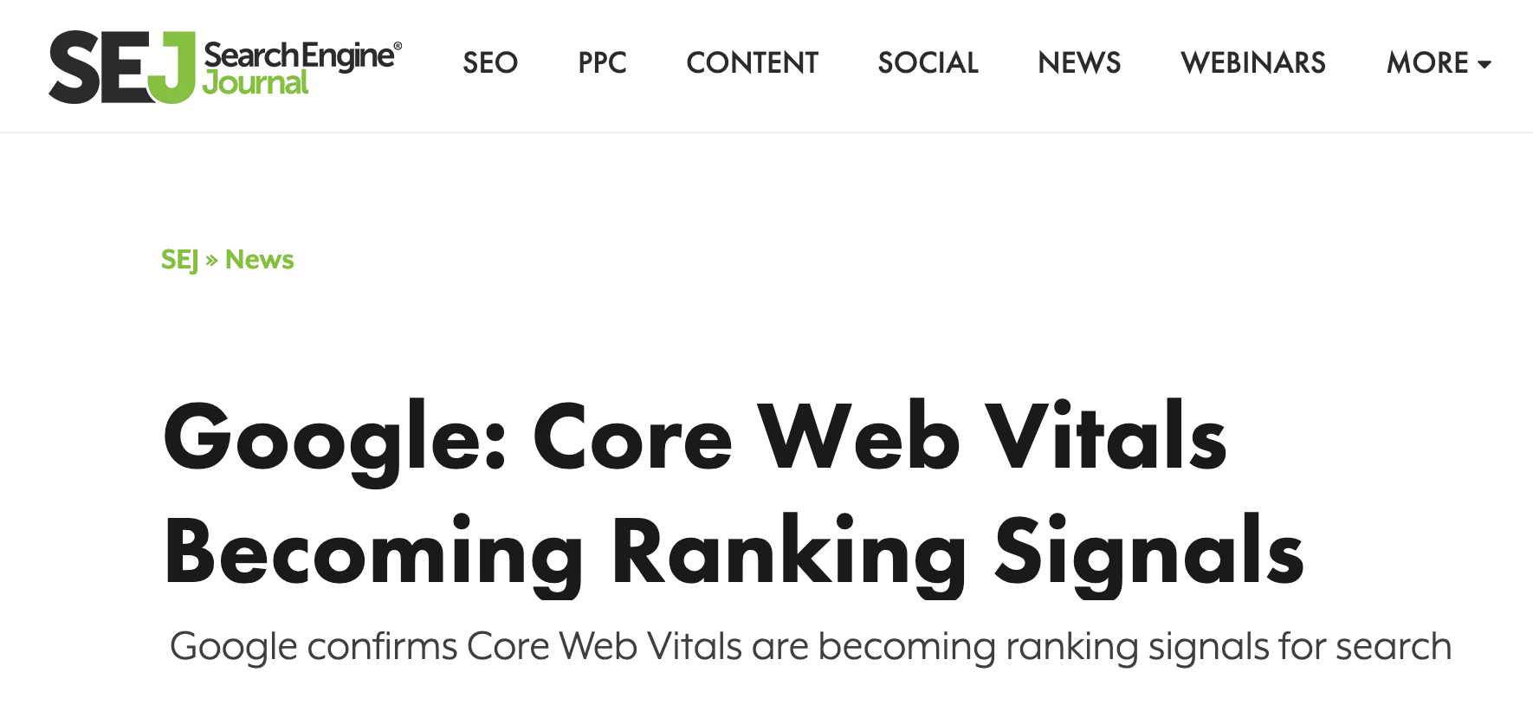
Fast Websites Can Rank Better on Google
Here is Google’s official position.
Your Logo Here
Notes:
Google announced in 2020 that Core Web Vitals user experience signals will become part of their ranking factors in 2021. They’d originally projected May 2021, and now are saying they’ll roll out CWV between June and August 2021

Slide 7

New in 2021:
Google Core Web Vitals
Your Logo Here

Slide 8
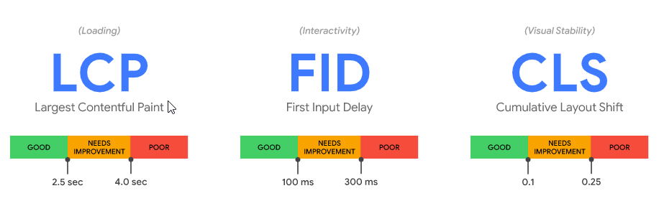
Google Core Web Vitals
Google’s new metrics for quickly summarizing the user experience performance of a website.
Three important metrics:
Loading Speed - LCP (Largest Contentful Paint)
Interactivity - FID (First Input Delay)
Visual Stability - CLS (Cumulative Layout Shift)
Your Logo Here
Notes:
Note: These are not the “comprehensive” set of mechanisms that can be used to measure user experience. They are, however, the areas that Google can (and does) measure and report on at the current time.

Slide 9
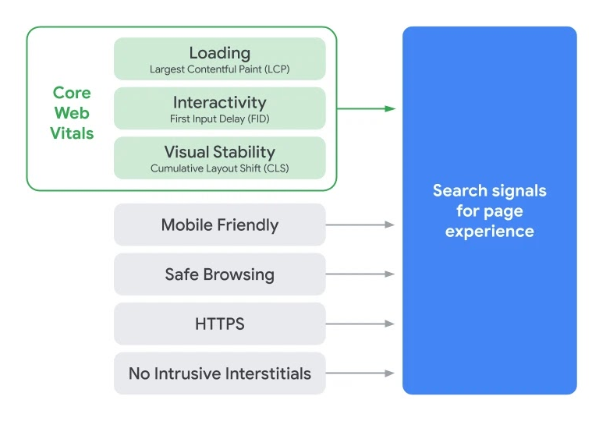
User Experience Matters
Google is measuring not only performance or speed, but they’re measuring for best practices related to the entire website experience.
Source
Your Logo Here

Slide 10

Web Vitals as a Ranking Factor
Web Vitals will join the other experience metrics as a Google ranking signal in summer 2021.
This is Google’s most specific performance metrics to date — we’ve never had anything close to this level of detail related to performance.
Note that this is a signal, not the only defining ranking factor.
Your Logo Here

Slide 11

Measuring Site Scores
Your Logo Here

Slide 12
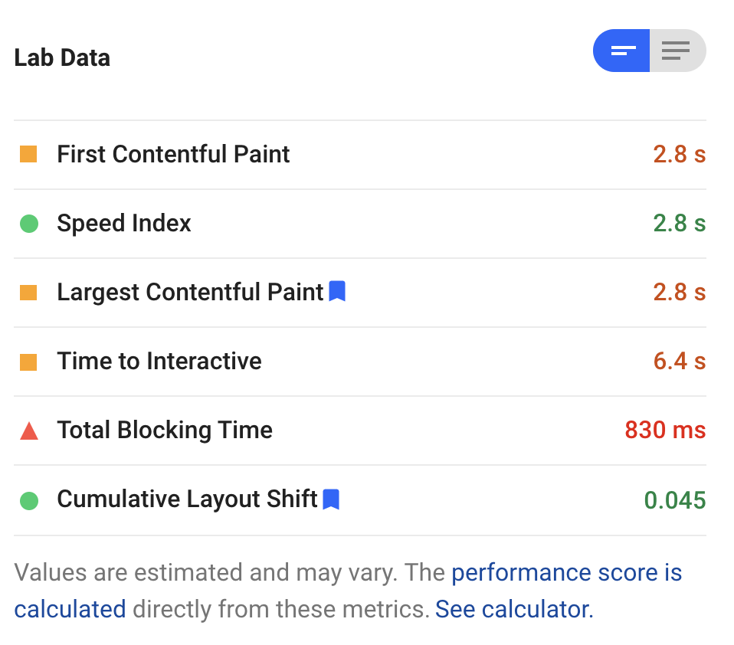
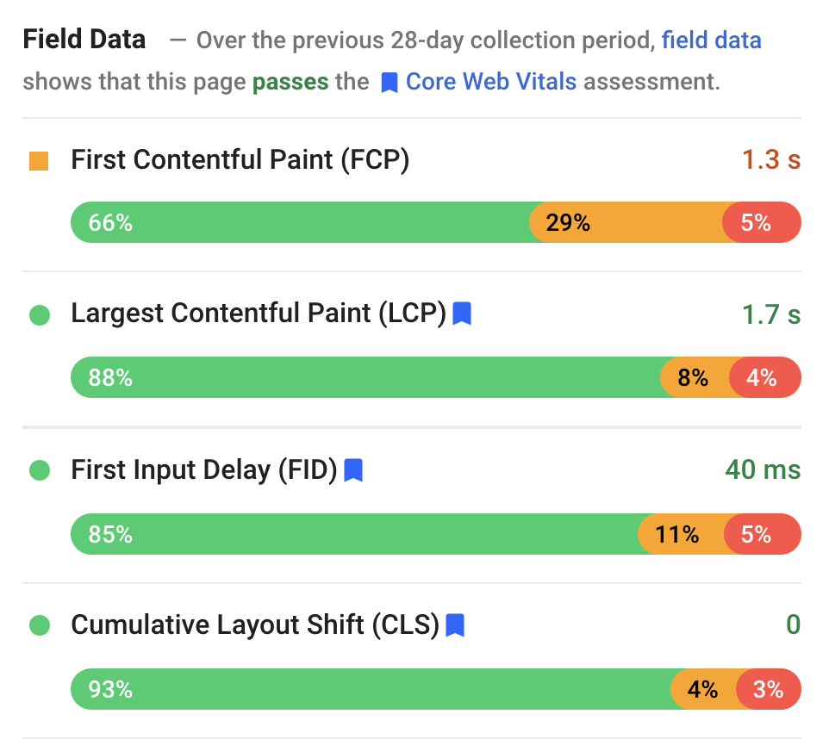
Google PageSpeed Insights
Measures a variety of website performance metrics
Lab Data* and Field Data**
* Lab data is only an estimate.
** Field data looks at prior 28 days of actual website activity, and reports for higher-traffic sites. Field data is more accurate and more representative.
Your Logo Here

Slide 13

What These Scores Mean
Your Logo Here

Slide 14
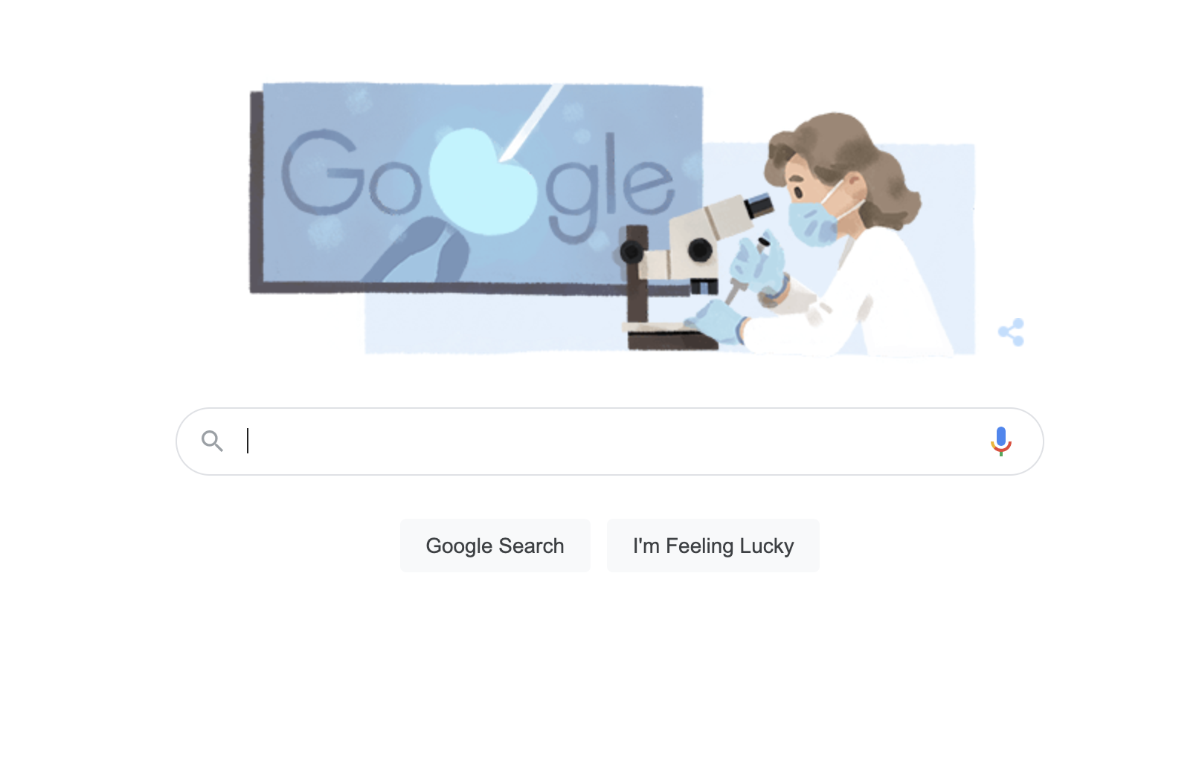
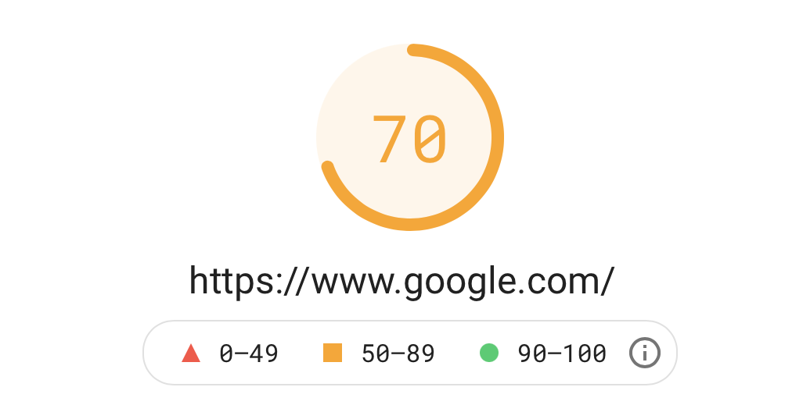
What is a Good Score on Pagespeed Insights?
Anything above 70 on Pagespeed Insights is a very strong score.
(Fun fact: Google.com itself typically scores in the upper 60s to low 70s.)
.
Your Logo Here
Notes:
Source: https://www.searchenginejournal.com/core-web-vitals-benchmarks/377324/

Slide 15
What is a Good Score for Core Web Vitals?
According to a recent study by HTTPArchive, only 20% of websites across the web score “good” on all three Core Web Vitals metrics on mobile devices
Your Logo Here
Notes:
Source:https://almanac.httparchive.org/en/2020/seo#core-web-vitals-experiences-per-device

Slide 16
Things That Can Slow Your Site Down...
Home pages with unoptimized images or unoptimized videos above the fold
Custom code at top of page
Third-party tracking pixels / analytics
Pages with multiple instances of large media objects (images, sliders, videos, etc.)
Externally hosted embeds
Excessive font usage
Heavy 3rd party widgets above the fold
Eg. Facebook, Map, Video, Image slider/gallery, above the fold.
Your Logo Here

Slide 17

What We Can Help You With
Performing a performance audit of your website
Improving your website performance based on that audit
Getting you results!
Your Logo Here

Slide 18
Your Logo Here
Fast Websites Matter:
Google Core Web Vitals & Site Speed
Youragency.com | 1-415-555-1212 | contact@youragency.com

